Slide 1
Displaying number in the Seven Segment Display and Designing a User Defined Protocol using Arduino and IR Remote Control

Slide 2
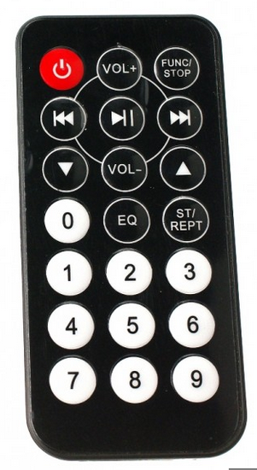
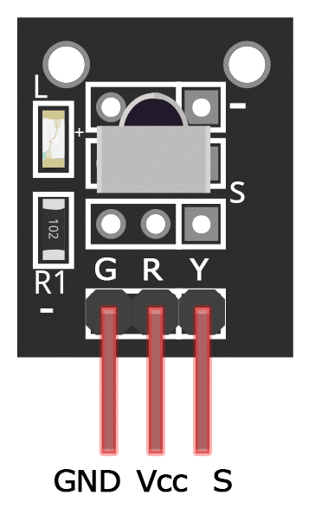
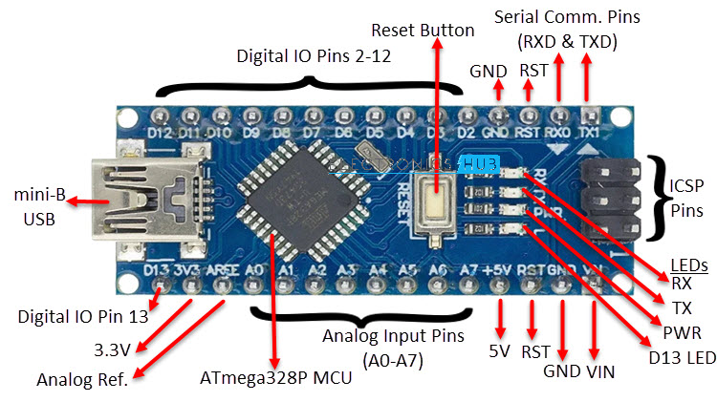
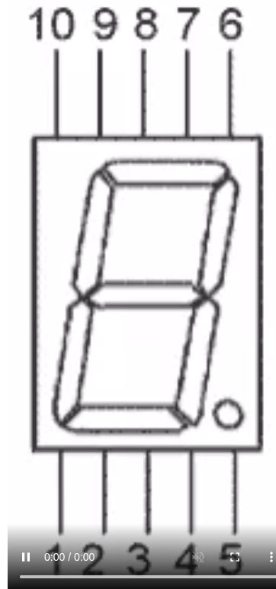
Required Instruments
Arduino Nano
IR Remote Control
IR Receiver
Seven Segment Display

Slide 3
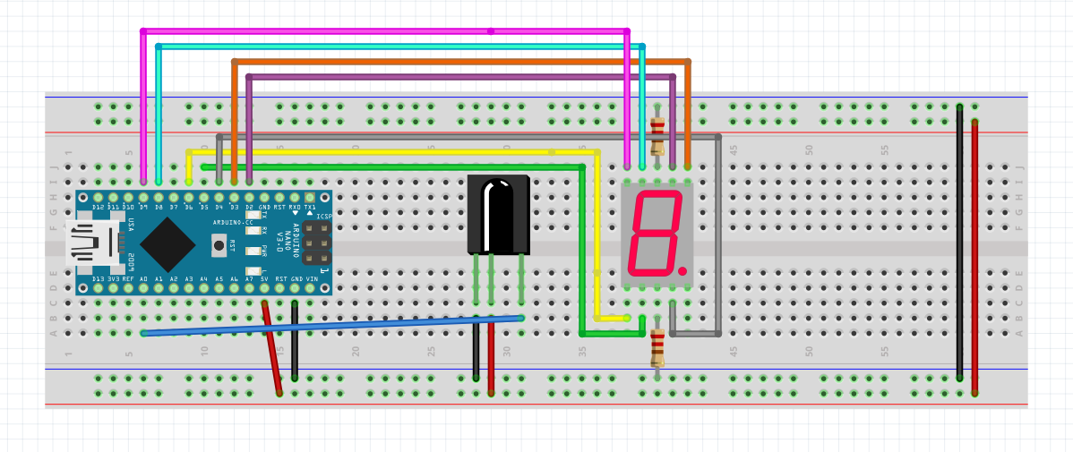
Circuit Diagram

Slide 4
Displaying the Number
Source Code (link)
Output

Slide 5
Pin Mapping
*******Pin map from Seven Segment Display to Arduino**********
1. Seven Segment Display pin 1 to Arduino pin D6
2. Seven Segment Display pin 2 to Arduino pin D5
3. Seven Segment Display pin 3 to GND with a resistor
4. Seven Segment Display pin 4 to Arduino pin D4
5. Seven Segment Display pin 6 to Arduino pin D3
6. Seven Segment Display pin 7 to Arduino pin D2
7. Seven Segment Display pin 8 to GND with a resistor
8. Seven Segment Display pin 9 to Arduino pin D8
9. Seven Segment Display pin 9 to Arduino pin D9
****Pin map from IR Receiver to Arduino**********
1. IR Receiver pin G to GND
2. IR Receiver pin R to Vcc
3. IR Receiver pin S to Arduino pin A0

Slide 6
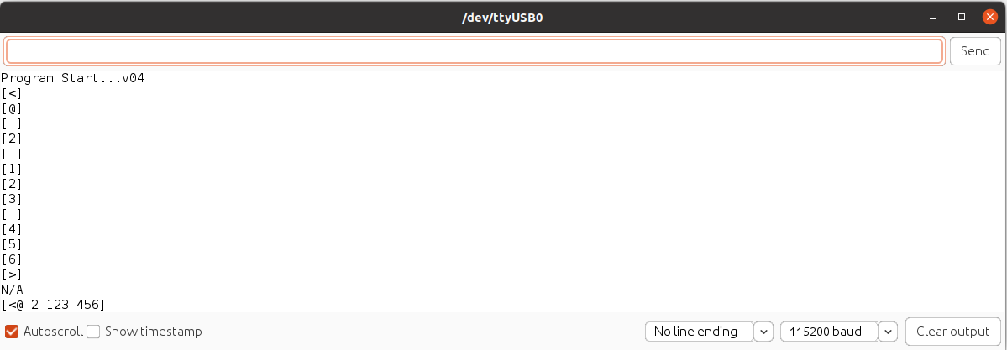
Protocol Design
Source Code
Output

Slide 7
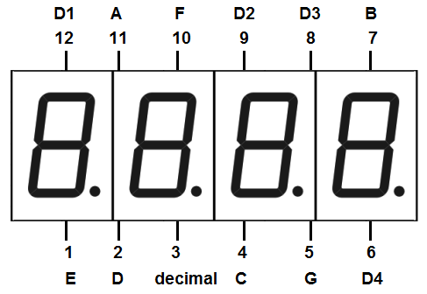
4 Digit Seven Segment Display
Pin Diagram of 4 Digit Seven Segment Display

Slide 8
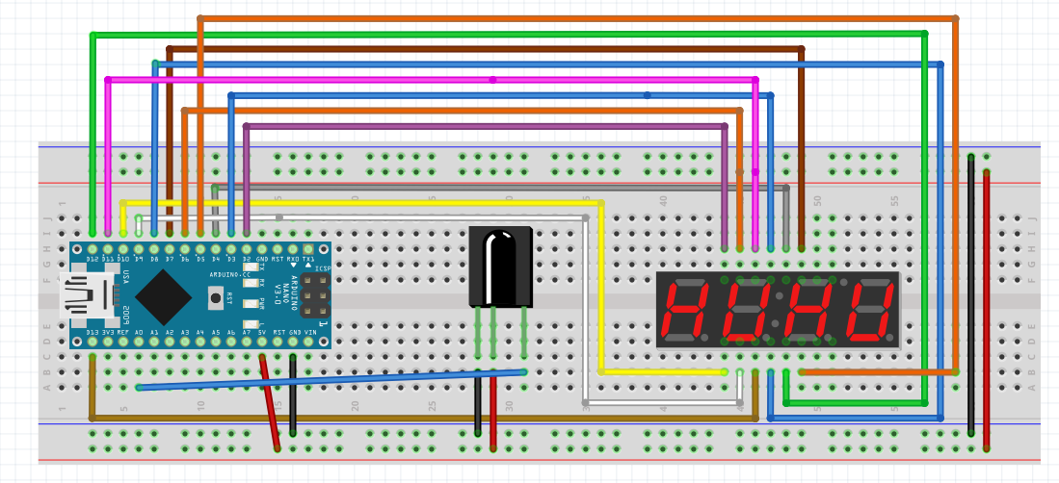
Circuit Diagram

Slide 9
Pin Mapping
*******Pin map from Seven Segment Display to Arduino**********
1. Seven Segment Display pin 1 to Arduino pin D10
2. Seven Segment Display pin 2 to Arduino pin D9
3. Seven Segment Display pin 3 to Arduino pin D13
4. Seven Segment Display pin 4 to Arduino pin D8
5. Seven Segment Display pin 5 to Arduino pin D12
6. Seven Segment Display pin 6 to Arduino pin D5
7. Seven Segment Display pin 7 to Arduino pin D7
8. Seven Segment Display pin 8 to Arduino pin D4
9. Seven Segment Display pin 9 to Arduino pin D3
10. Seven Segment Display pin 10 to Arduino pin D11
11. Seven Segment Display pin 11 to Arduino pin D16
12. Seven Segment Display pin 12 to Arduino pin D2

Slide 10
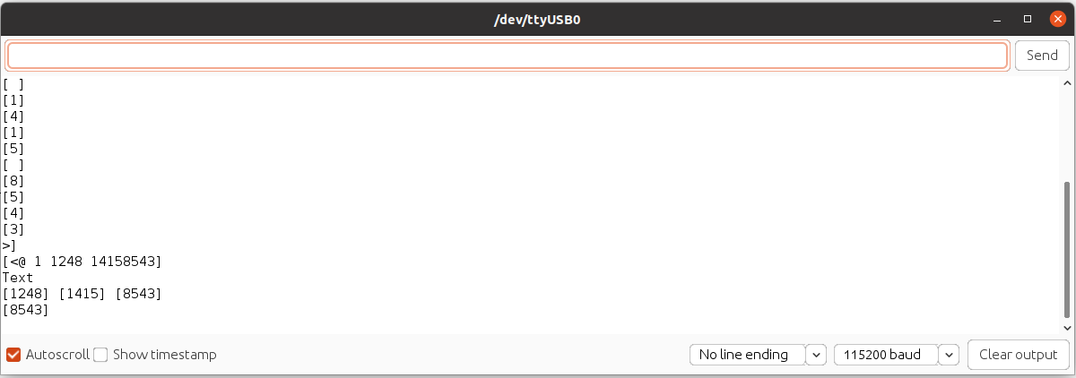
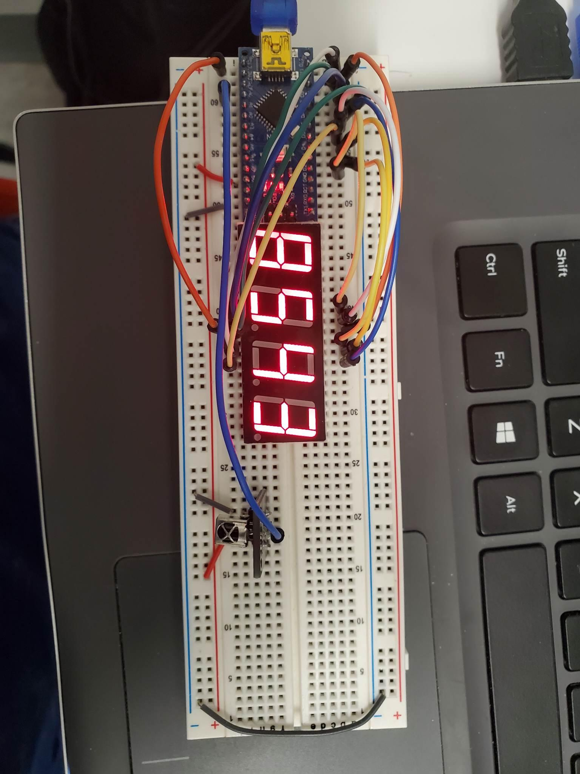
Output

